Slide 1
e!COCKPIT dynamic Configuration
1. Initialize the terminal list with the method : terminalmanager.InitTerminalList(oStatus)

Slide 2
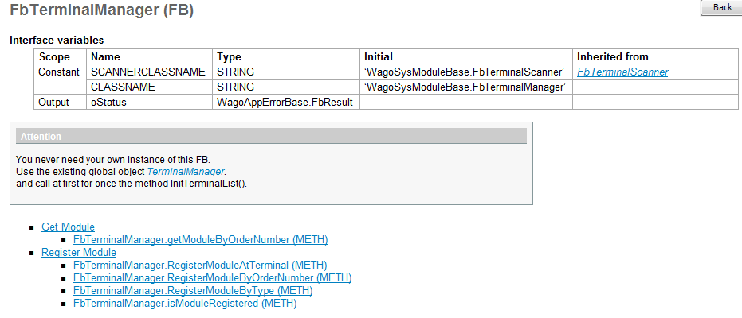
e!COCKPIT dynamic Configuration

Slide 3
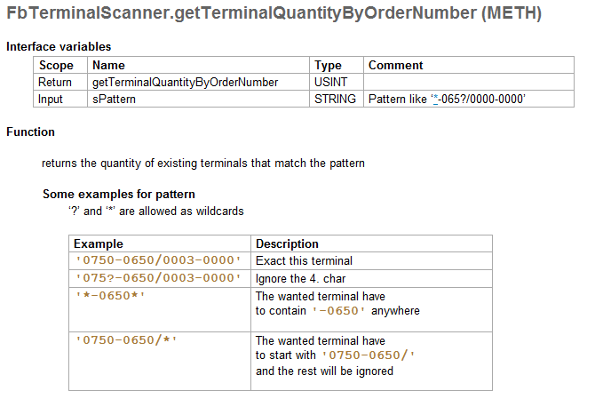

e!COCKPIT dynamic Configuration

Slide 4
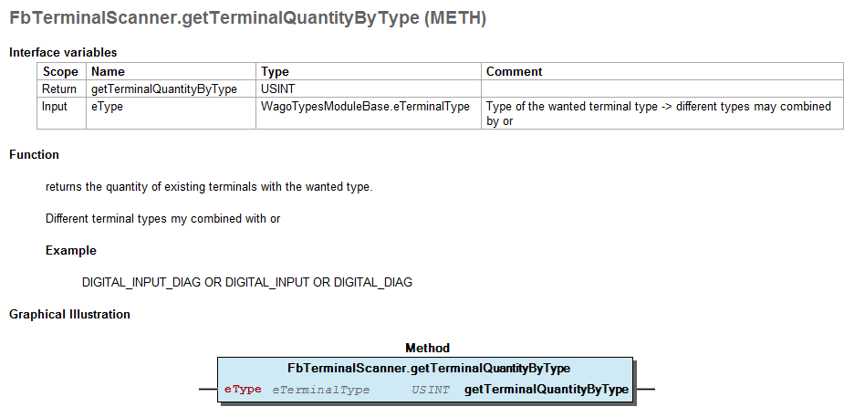
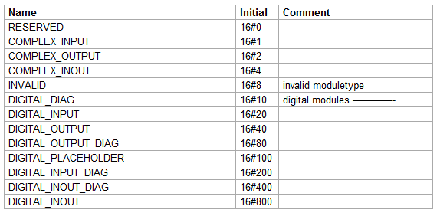
e!COCKPIT dynamic Configuration

Slide 5
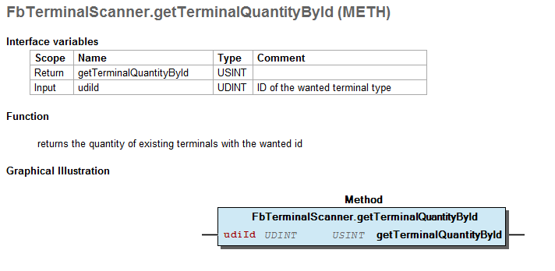
e!COCKPIT dynamic Configuration

Slide 6
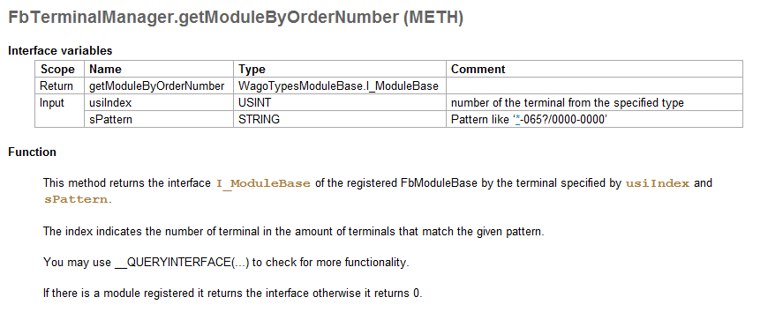
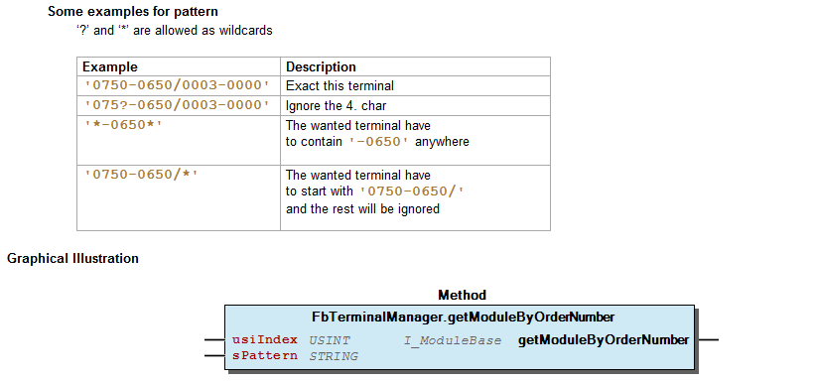
e!COCKPIT dynamic Configuration

